Slide 1
Bivariate Hypothesis Testing
SSI II
January 30, 2018

Slide 2
Previously…
Hypotheses and null hypotheses
Statistical inference
Confidence intervals
Univariate hypothesis testing

Slide 3
Essential Questions
How do we decide what type of test to use?
What do hypothesis tests tell us?

Slide 4
Review - Univariate
"Do you think each of the federal crackdown on undocumented immigrants is a good thing for the country or a bad thing for the country?
Good thing – 46%
Bad thing – 47%
Mixed or unsure – 7%
N=1005, Jan 15-18

Slide 5
Review - Univariate
Suppose one advisor suggests Trump should pull back on the crackdown, since there is not a majority in favor. Miller argues that 46% is close to 50% and it could just be polling error. They turn to you – what would you say?
Null Hypothesis? Alternative Hypothesis?
z-statistic?
p-value?
Final response?

Slide 6
Review - Univariate
H₀: At least 50% of the population supports suspending immigration from these regions.
H_{A}: Less than 50% of the population supports suspending immigration from these regions.

Slide 7
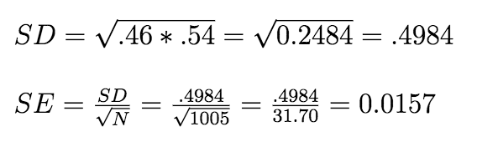
Review - Univariate
z=(observed-expected)/standard error
z=(.46-.50)/.0157
z=-.04/.0157
z=-2.548
Notes:
$SD = \sqrt{.46*.54}=\sqrt{0.2484}=.4984$ \\
$SE = \frac{SD}{\sqrt{N}} = \frac{.4984}{\sqrt{1005}} = \frac{.4984}{31.70} = 0.0157$\\

Slide 8
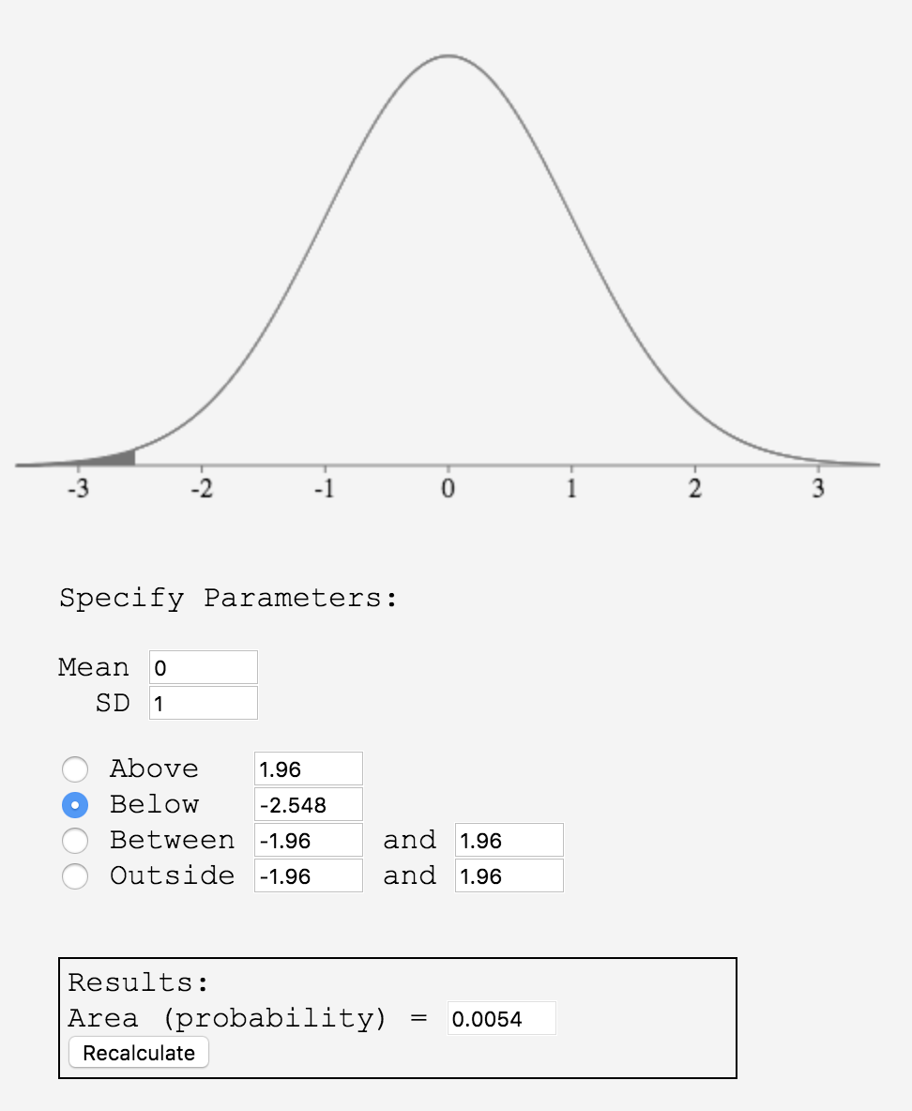
Review – Univariate

Slide 9
Review - Univariate
We can only be 99.9946% confident that there is less than 50% support for the crackdown among the American population
We would reject the null, and Miller would be incorrect that it could just be polling error

Slide 10
What test?
Which test you choose depends on:
How many variables you have
What types of variables you have
For today, the answer to the first question is two (bivariate tests)

Slide 11
Which Bivariate Test?
 |  | Independent Variable Type
Dependent Variable Type |  | Categorical | Continuous
 | Categorical | Tabular Analysis | Probit/Logit
 | Continuous | Difference of Means | Correlation Coefficient; Bivariate Regression Model

Slide 12
Tabular Analysis/Cross-tabulation
Use this when independent and dependent variables are both categorical
Dependent variable: Donate to campaign
Independent variable: Level of partisanship
Donated? | Independent | Weak | Moderate | Strong
No | 91.8% (123) | 71.6% (101) | 87.5% (314) | 68.0% (219)
Yes | 8.2% (11) | 28.4% (40) | 12.5% (45) | 32.0% (103)
Totals | 100% (134) | 100% (141) | 100% (359) | 100% (322)
Note: Cell entries are percentages (and frequencies)
Notes:
CBS News poll, April 8-12, 2015, 1012 adults nationwide, margin of error is plus or minus 3

Slide 13
Tabular Analysis
Null hypothesis: Distributions are the same across groups
Alternative hypothesis: Distributions differ

Slide 14
Example
Independent variable: PR Electoral System?
Dependent variable: Effective # of Parties (ENP) as an ordinal measure: 1-3, 4-5, 6-11
Null hypothesis: Relative frequency of responses (within-column percentages) do not depend on system
Alternative hypothesis: Relative frequency of responses (within-column percentages) differ by system
Notes:
PR Electoral System: 各州的席位都由两党分摊 (easy for small parties to survive)

Slide 15
Example
ENP | PR System | Non-PR System | Total
1-3 | 37.29% (22) | 60.76% (48) | 50.72% (70)
4-5 | 28.81% (17) | 18.99% (15) | 23.19% (32)
6-11 | 33.90% (20) | 20.25% (16) | 26.09% (36)
Total | 100% (59) | 100% (79) | 100% (138)
Note: Cell entries are percentages (and frequencies)

Slide 16
Example: Expected Frequencies
Null Hypothesis: If the null hypothesis (of no relationship) is true then the percentages across each row should be the same as each other and the row totals
ENP | PR System | Non-PR System | Total
1-3 |  |  | 50.72% (70)
4-5 |  |  | 23.19% (32)
6-11 |  |  | 26.09% (36)
Total | 59 | 79 | 100% (138)
Note: Cell entries are percentages (and frequencies)

Slide 17

Chi-Squared Statistic
The chi-squared statistic summarizes the difference between expected and observed frequencies
If the null hypothesis is true, the observed and expected frequencies should be the same and the chi-squared statistic should be 0

Slide 18
Chi-squared Statistic
To compute the chi-squared statistic:
Find the difference between observed and expected for each cell in the cross tab
For each difference, square it and divide by the expected frequency
Add up the resulting ratios

Slide 19
Example: Chi-squared Statistic
ENP | PR System | Non-PR System | Total
1-3 | O:22 E:29.92 | O:48 E:40.07 | 70
4-5 | O:17 E:13.68 | O:15 E:18.32 | 32
6-11 | O:20 E:15.39 | O:16 E:20.61 | 36
Total | 59 | 79 | 138
Note: Cell entries are frequencies

Slide 20
Chi-squared Test
Follows the chi-squared distribution
Degrees of freedom=(# rows-1)(# columns-1)
Note: For the chi-squared test, we don’t have to worry about the direction (one or two tails)

Slide 21
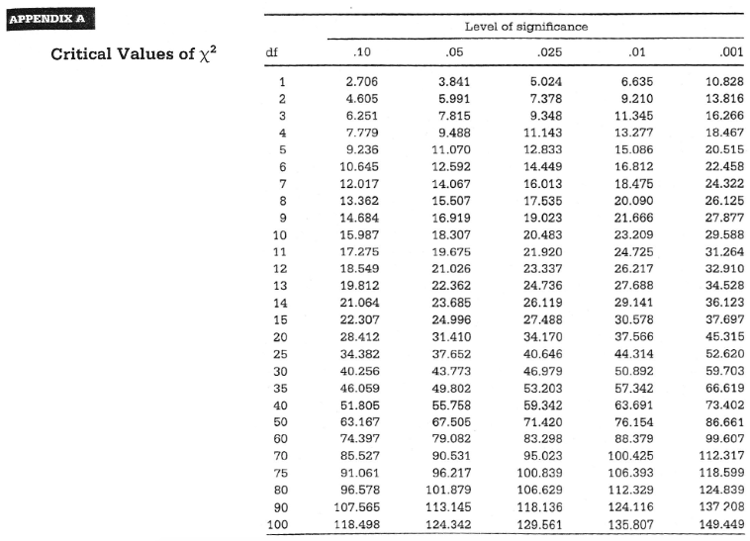

Slide 22
Difference of Means
Question: Is there a difference between the average age of voters and non-voters?
Dependent variable = Age of individuals (continuous)
Independent variable = Voters or non-voters (categorical)
Null hypothesis: There is no difference in the average age of voters and non-voters
Alternative hypothesis: There is a difference in the age of voters and non-voters

Slide 23
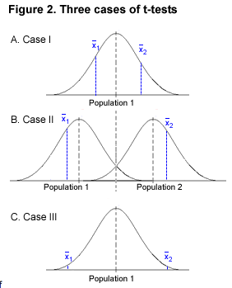

Slide 24
Difference of Means
Categorical IV, Continuous DV
Example Question: Is there a difference between the average age of voters and non-voters?
Group | N | Mean | Std Dev
Voters | 60 | 47.5 | 17.0
Non-voters | 45 | 42.8 | 19.6

Slide 25
Difference of Means
Null hypothesis: Underlying population distributions of Y₁ and Y₂ have the same mean
Alternative hypothesis: Population distributions of Y₁ and Y₂ have different means
Intuition behind the hypothesis test: If the null hypothesis is true, some difference in means will occur by chance, but how likely would it be?

Slide 26



Difference of Means
Group means:
Null hypothesis:
(Group means are equal)
Alternative Hypothesis:
(Group means are unequal

Slide 27
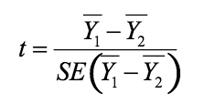

Test Statistic is the T-Test
How far the means are from one another, moderated by the standard error
The further apart the two means are and the less dispersed the distributions, the more confident we can be that the means are different
where

Slide 28
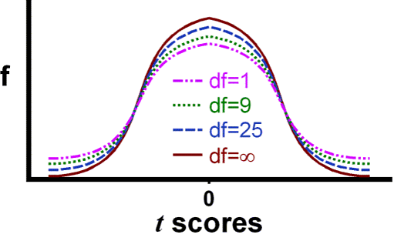
Sampling Distribution for t-test
The t-statistic has a t distribution, which depends on the number of degrees of freedom (usually number of observations minus parameters)

Slide 29
One-tailed test vs. two-tailed test
Is your alternative hypothesis directional?
Do you have a prediction about which way the relationship exists?
If yes -> one-tailed test
If no -> two-tailed test
Big Caveat: Despite the fact that political/social scientists almost always have directional hypotheses, we also almost always use a two-tailed test.

Slide 30



One-tailed test vs. two-tailed test
Two-sided hypothesis test: Doesn’t involve direction
One-sided hypothesis test: Involves expectations about the direction of the difference

Slide 31
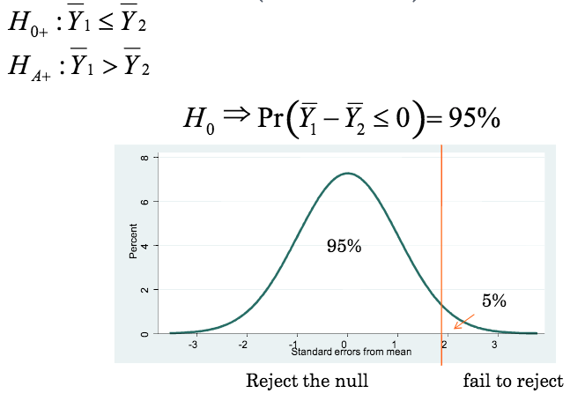
One-tailed Test (Right Tail)
Fail to reject null
Reject null

Slide 32
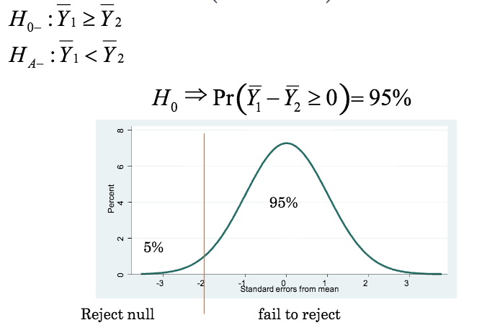
One-tailed test (Left Tail)

Slide 33
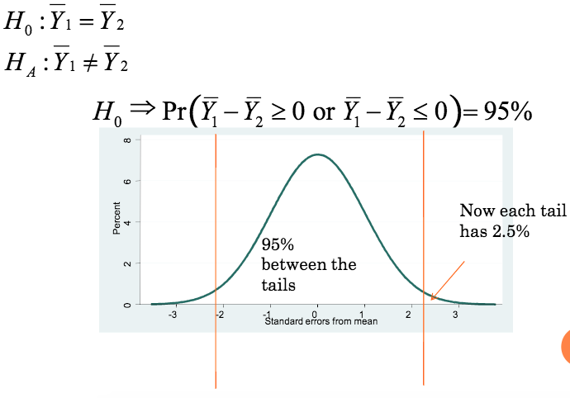
Two-tailed Test

Slide 34
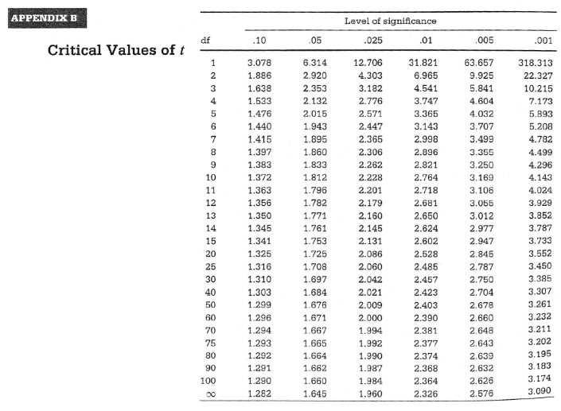
v
One-Tailed Test
v

Slide 35
v
Two-Tailed Test
v

Slide 36
Critical Values for t-test
If c(level) is the critical value for the specified significance level in a t-table:
If your alternative hypothesis is… | Reject H₀ at 95% confidence level if…
Group 1 mean > Group 2 mean (right-tailed) | t>c(.05)
Group 1 mean < Group 2 mean (left-tailed) | t<-c(.05)
Group 1 mean > Group 2 mean Or Group 1 mean < Group 2 mean (two-tailed) | |t| > c(.025)

Slide 37
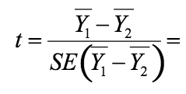
Example
Group | N | Mean | Std Dev
Voters | 60 | 47.5 | 17.0
Non-voters | 45 | 42.8 | 19.6

Slide 38
Example
T=1.3127
Alternative Hypothesis | Critical Value | Conclusion
Voters are older than non-voters (right-tailed)
Voters are younger than non-voters (left-tailed)
Voters are either older or younger than non-voters (two-tailed)

Slide 40
Exercise
T=1.3
Alternative Hypothesis | Critical Value | Conclusion
Voters are older than non-voters (right-tailed) | 1.660 | Fail to reject H₀
Voters are younger than non-voters (left-tailed) | -1.660 | Fail to reject H₀
Voters are either older or younger than non-voters (two-tailed) | 1.984 | Fail to reject H₀

Slide 41
Essential Questions
How do we decide what type of test to use?
What do hypothesis tests tell us?

Slide 42
Next Time…
Correlation for two continuous variables

